Slide 1



K.S. School of Engineering and Management Department of Electronics and Communication Engineering
INTERSHIP PRESENTATION
on
“DC ENERGY METER”
Internship carried out at
Presented By
SHREYAS B R
1KG16EC091
ON 20-08-2020
Internal Internship Guide
MRS. KRIPA K B
Assistant. Prof, ECE, KSSEM
External Internship Guide
Mr. Raghavendra Rao
Atels

Slide 2
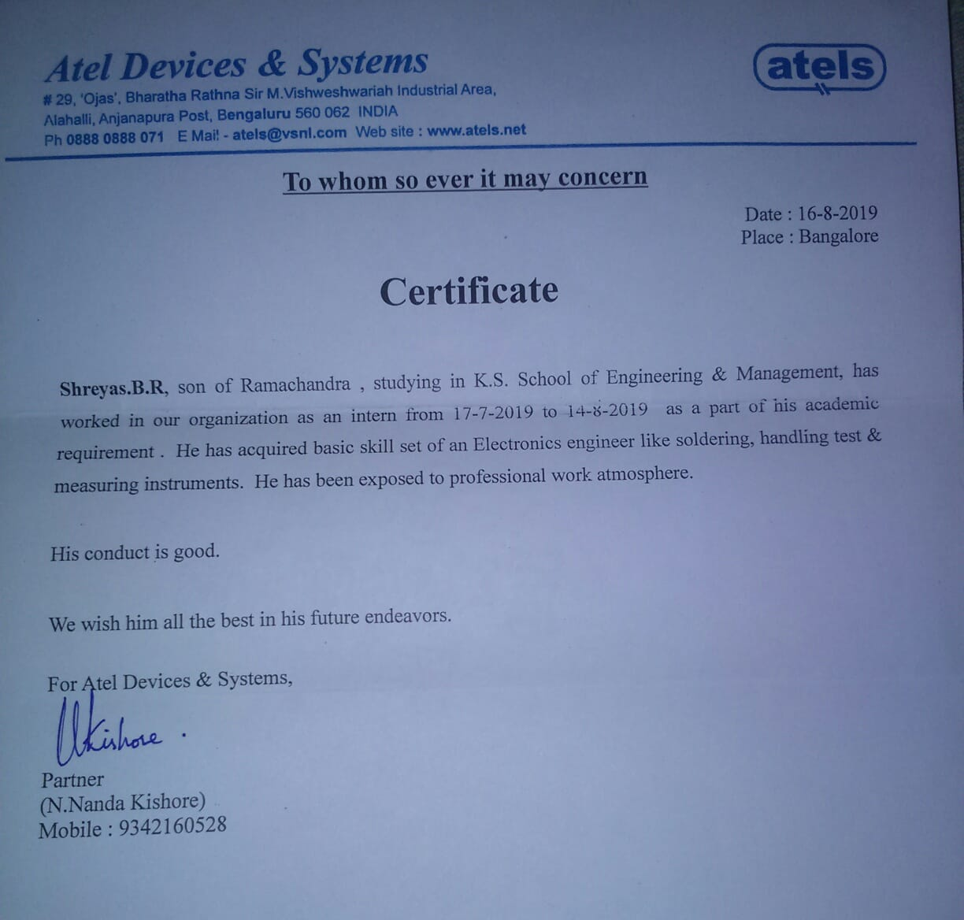

Slide 3
CONTENTS
Company Profile
DC Energy Meter
Work assigned
Execution
Application
Conclusion

Slide 4
COMPANY PROFILE
ATEL DEVICES & SYSTEMS was established with an objective to bring in high-end engineering technology to the industrial sector at a time when the world is fast embracing it.
ATEL boasts of a very strong base in Electrical Measurement & Instrumentation. ATEL has catered to Measurement requirements of Aircrafts, Power stations, Research Laboratories, Telecommunication Exchanges, Telecommunication Towers.
ATEL has been the core of all the products adding power & intelligence to routine measurements enabling ATEL as trendsetters at several points.

Slide 5
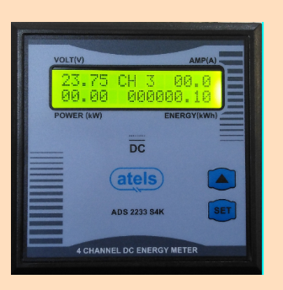
DC ENERGY METER
ADS 2233 S4K model.
4 Channel Display Integrated DC Energy Meter.
User Selectable Current Input 50A-250A.
Wide Input Voltage 18-65V
Displays DC Voltage, Current, Power & Energy.
User Selectable Shunt mV Input 5mV-99mV.
RS 485 Port for external communication.
16X2 backlit Alphanumeric LCD Display
Date and time are displayed.

Slide 6
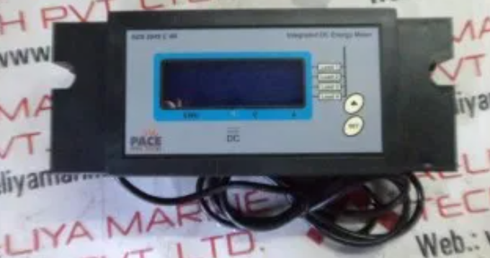
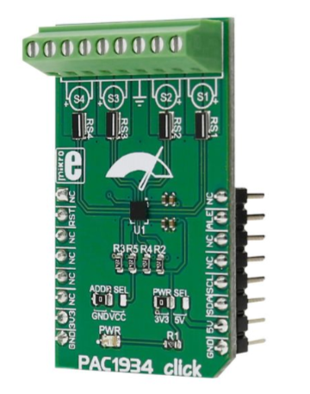
CHANNEL DISPLAY
It’s a 16x2 display.
Voltage , Current , power and Energy are displayed in the channel.
Four channels are used for the DC energy meter.
PCB Channel display Channel Display

Slide 7
WORK ASSIGNED
DC 2233 is a Microcontroller based Integrated Digital Meter to measure Multiple parameters on DC power Management applications. The general range available is 48V DC & 100A DC.
Multiple channels 4 and is economically priced.
Measures & Displays DC Volt, DC Current , DC Energy (KWHr) and DC power of each channel.

Slide 8
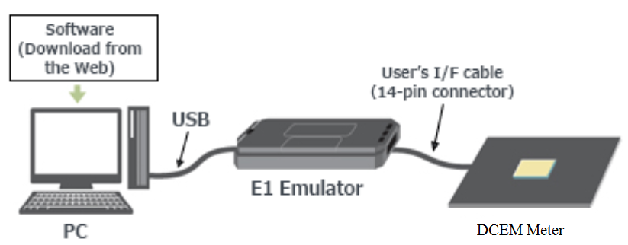
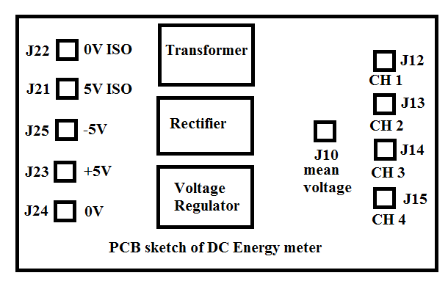
EXECUTION
HARDWARE TEST OF MOD2233 DCEM
Initially software will be dumped to the meter from Renesas flash programmer.
48V input is given to the meter from DC power supply.
check the output voltage 5V with respect to J23 to ground.
check the isolated voltage 5V with respect to J21 to ground.
Check the each channel voltage 1.25V with respect to J12, J13, J14 and J15 to ground.
Dumping the software to the DCEM meter.

Slide 9
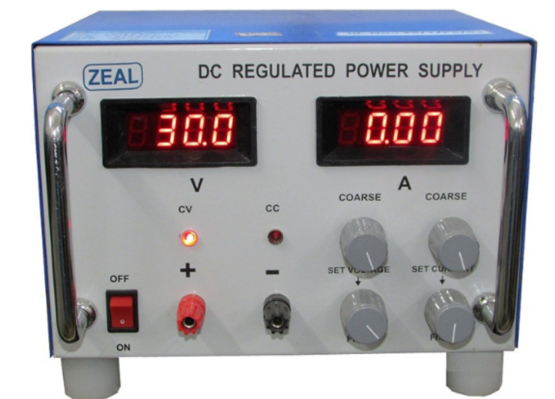
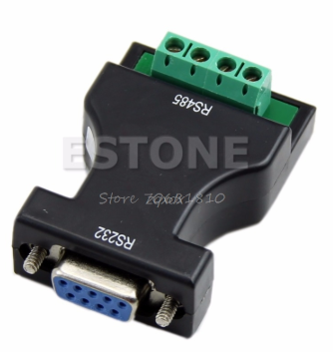
.
2.CALIBRATION PROCESS
RS-485 connector is used for communication between
DC energy meter and system.
48v input is given to the meter from DC Regulated power supply.
Initializing
→ DC energy meter
→ version 1.6 DC Regulated power supply
→ protocol 1
meter shows
voltage (48) CH1 amps (0.00)
power (0.00) energy (0000.00)
Press SET switch
View log
System setting
System settings (press SET)
Enter code : 215 (calibration code) RS-485 Serial Port

Slide 10
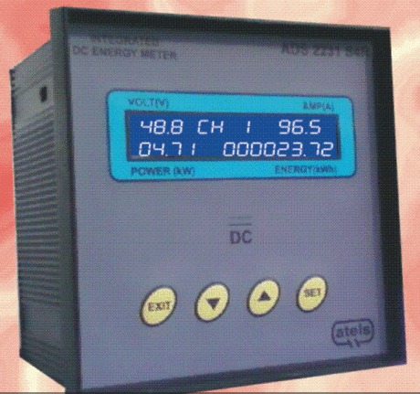
.
It shows
48.8 [V] channel 1 96.5 [I]
04.71 [W] 000023.72[J]
output of DC energy meter
3.BURN-IN
It’s a process where DC energy meter will be subjected to 48V input for 2-3 hours to make sure current ,voltage ,power ,energy , date and time are displayed.
4.FINAL TEST
Same calibration process will be done for the final test or it’s a verification test.

Slide 11
APPLICATIONS
Aircrafts
Telecommunication Towers
Nuclear Stations
Solar Power stations
Defence Agencies
Automobile Manufacturers
Railways

Slide 12
.
CONCLUSION
ATEL has been in the forefront of Embedded applications from over 20 years.
These energy meters are the core of all the products adding power & intelligence to routine measurements.
Due to DC energy meters the communications are processing at the high rate and are used most efficiently where ever required.
DC energy meters are safer than the AC energy meters.

Slide 13
Thank you!!

